Slide 1



Exploring Flutter A powerful Tool for Cross-Platform App Development
Franklin Developer Lunch & Learn
Meetup – Franklin, TN, USA
By Richard Hoehn – June 2024
GitHub Repo
GitHub PDF

Slide 2
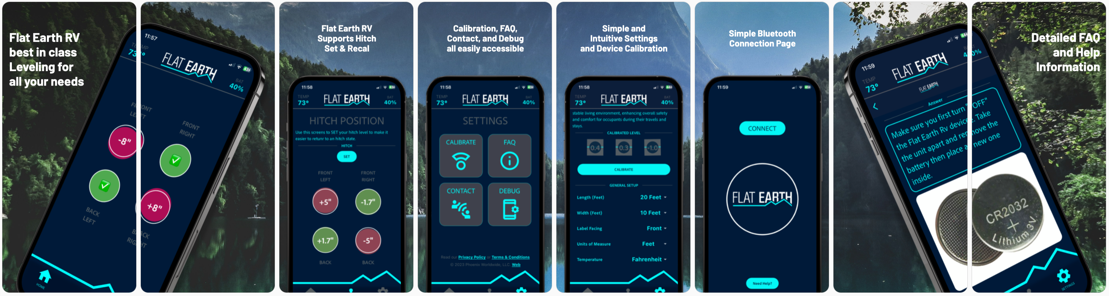
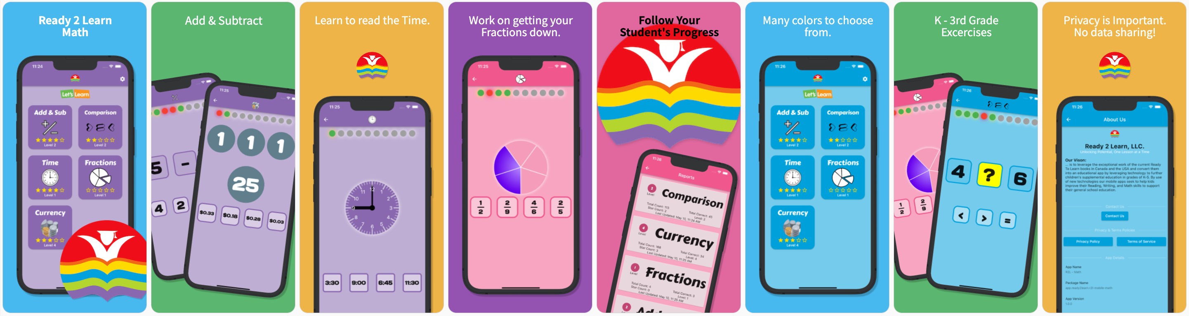
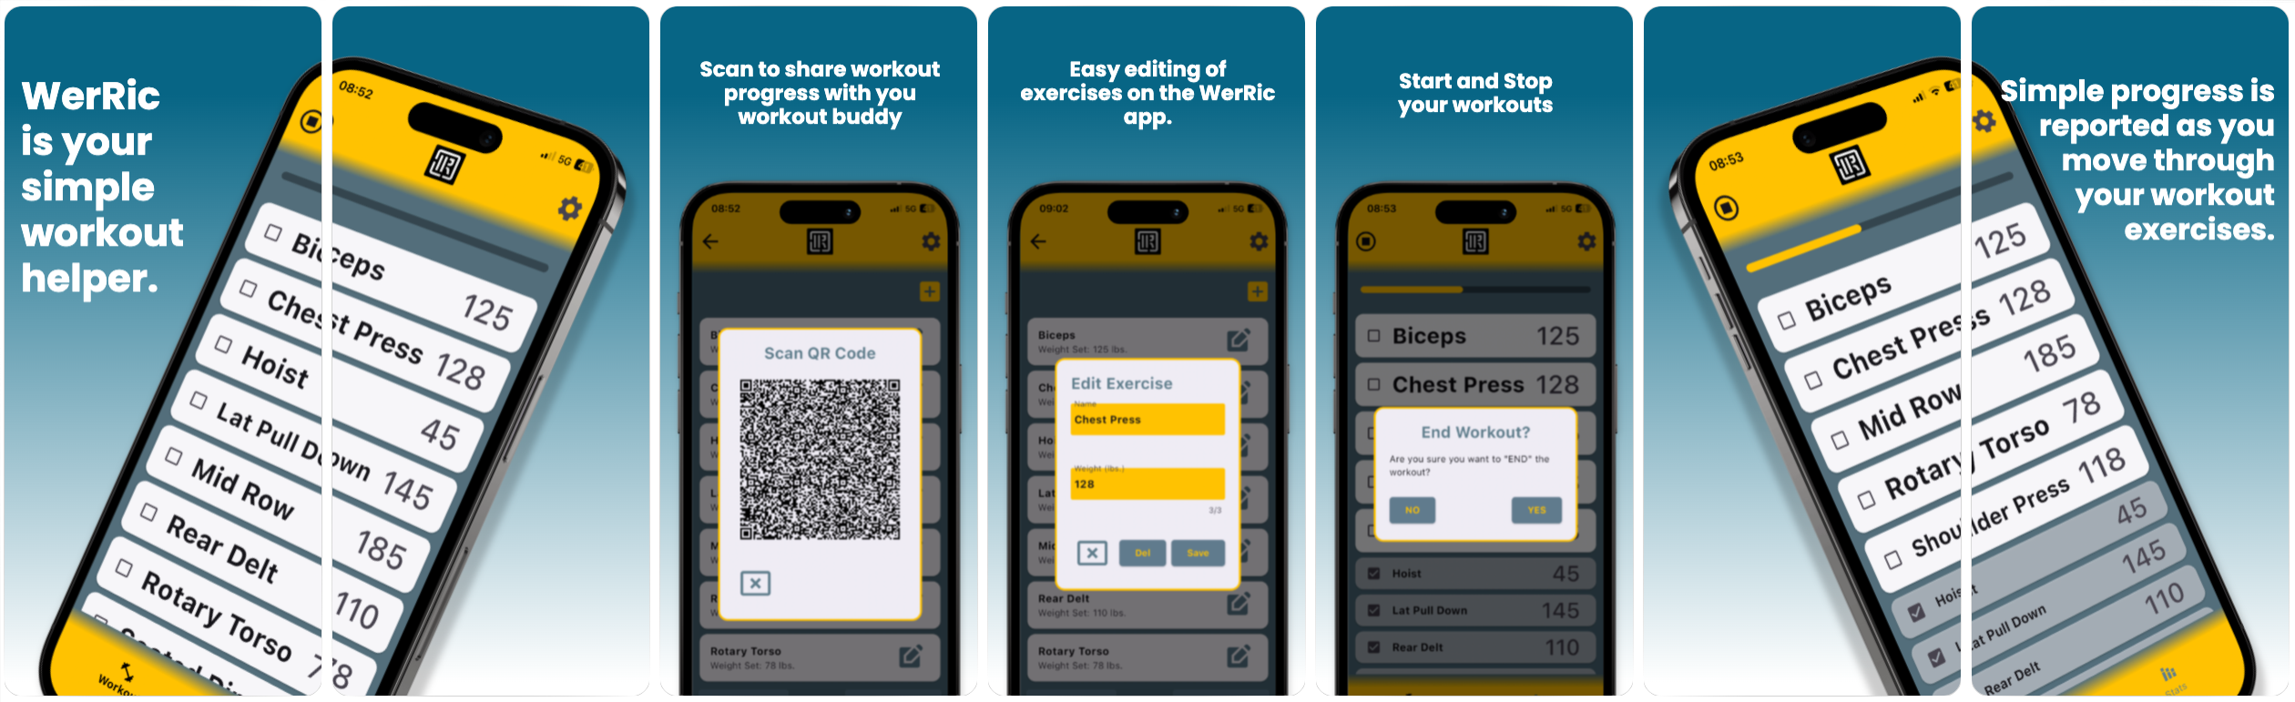

About Me
Living in Franklin, TN since 98 • Grew up in Switzerland Zurich Area • Machinist by Trade CNC Programmer ▼ PLC – Ladder Logic ▼ Embedded C – ARM & AVR ▼ App & Web Development

Slide 3
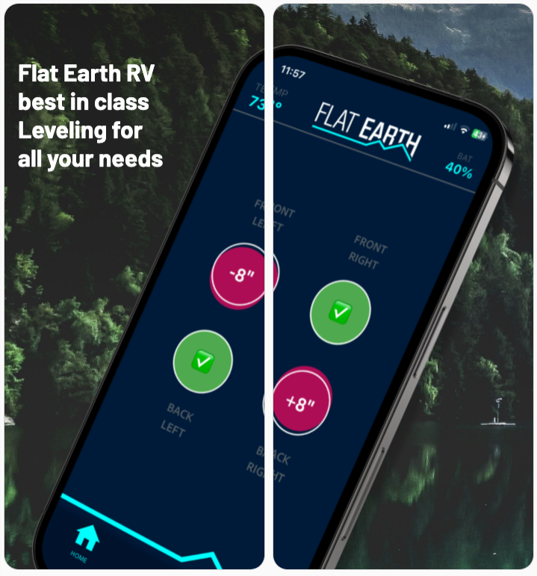
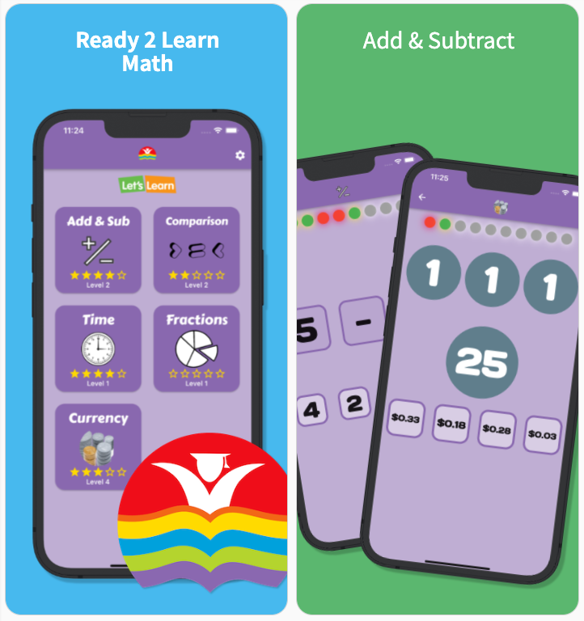
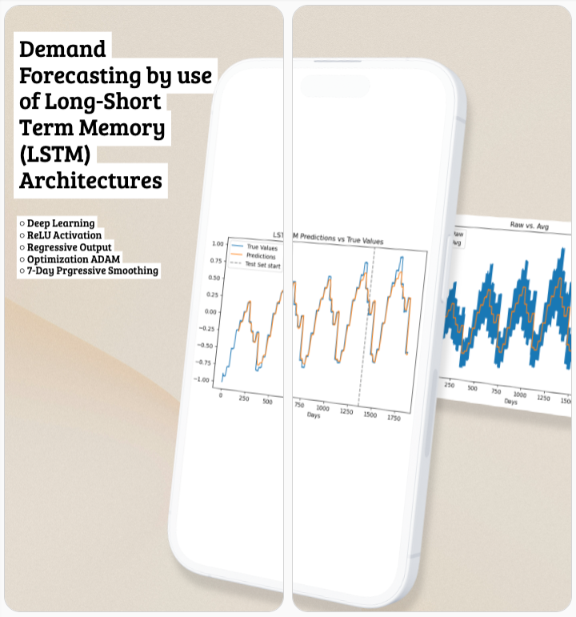
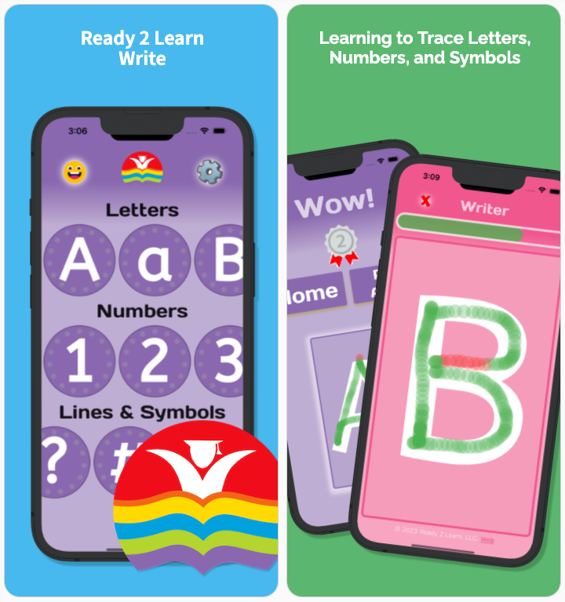
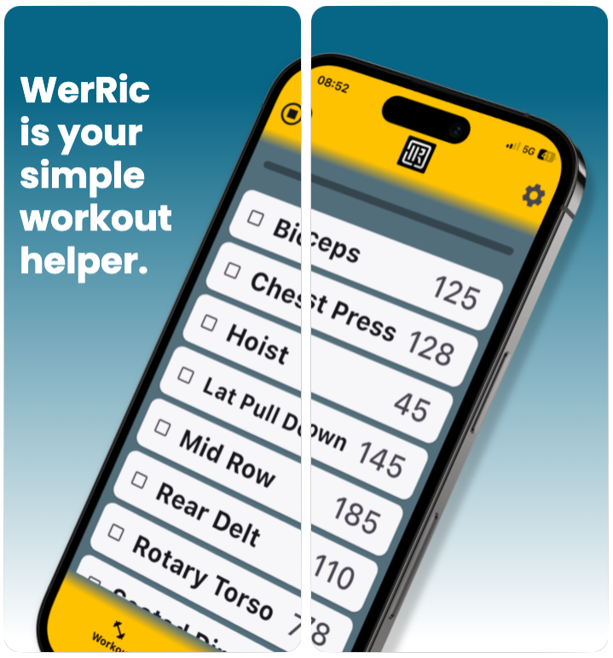
Introduction & Agenda
Introduction – Why I like Flutter…
A cross-platform UI development Platform | Framework | SDK – Code once!
Language Dart that is easy to use and Declarative in nature, but still strongly typed
Easy to use Tool-Chain and Good Documentation
and Finally Open-Source with a large community supporting module development
Agenda ~ 40min
What is Flutter, the Architecture, and the SDK Setup
Building an App, Widgets (both Stateless and Stateful), and the use of State Mgmt.
Firebase and how Google backend support enabled quick development
and finally, Review of Unique Features, Demo, and Conclusions

Slide 4

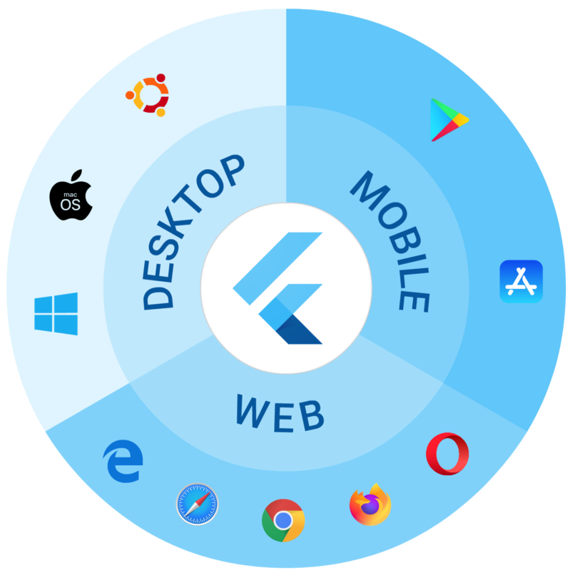
What is Flutter?
An open-source UI software development kit (SDK) created by Google – Released end of 2018.
•
Cross-platform app development allows developers to use one programming language and one codebase to build an application for multiple platforms.
Your Code is Native Compiled to
Mobile (iOS, Android)
Web
Desktop (Windows, macOS, Linux)
From a Single codebase!
https://medium.com/swlh/flutter-2020-state-of-cross-platform-814f1d8ff16

Slide 5

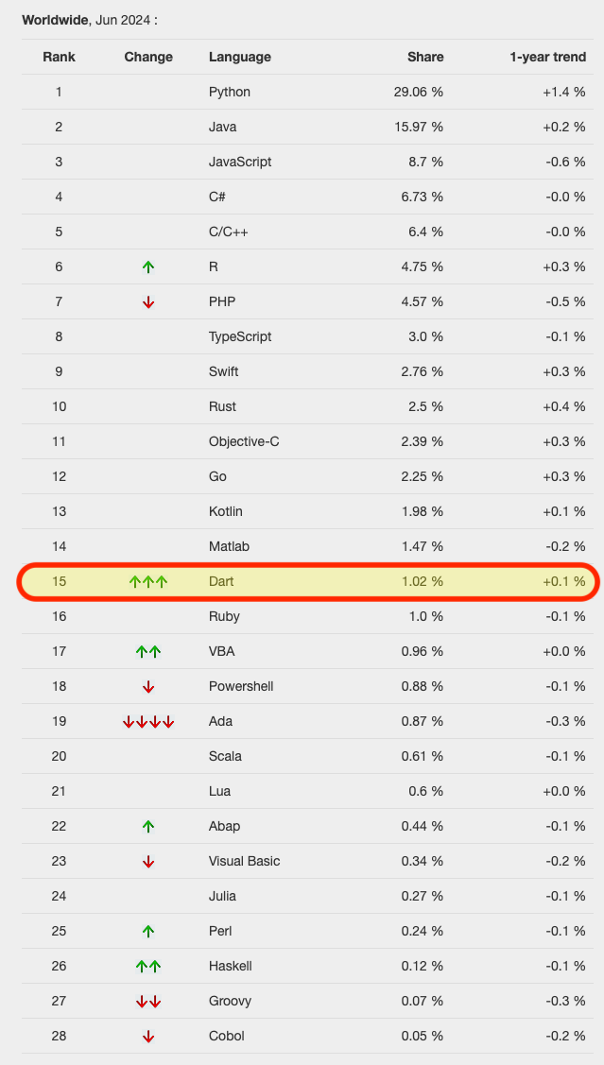
What is Flutter? Dart – Programing Language
Released by Google - 2011
Optimized for UI Development
Dart is designed with a focus on UI development due to it’s declarative nature.
It’s expansive standard library and easy syntax simplify the development of complex and responsive UIs.
Ahead-of-Time (AOT) & Just-in-Time (JIT) Compilation
AOT compilation enables Flutter apps to be compiled into optimized, native machine code, ensuring fast startup times and high performance.
JIT compilation allows for hot reload, enabling developers to see code changes in real-time without restarting the app.
https://pypl.github.io/PYPL.html

Slide 6
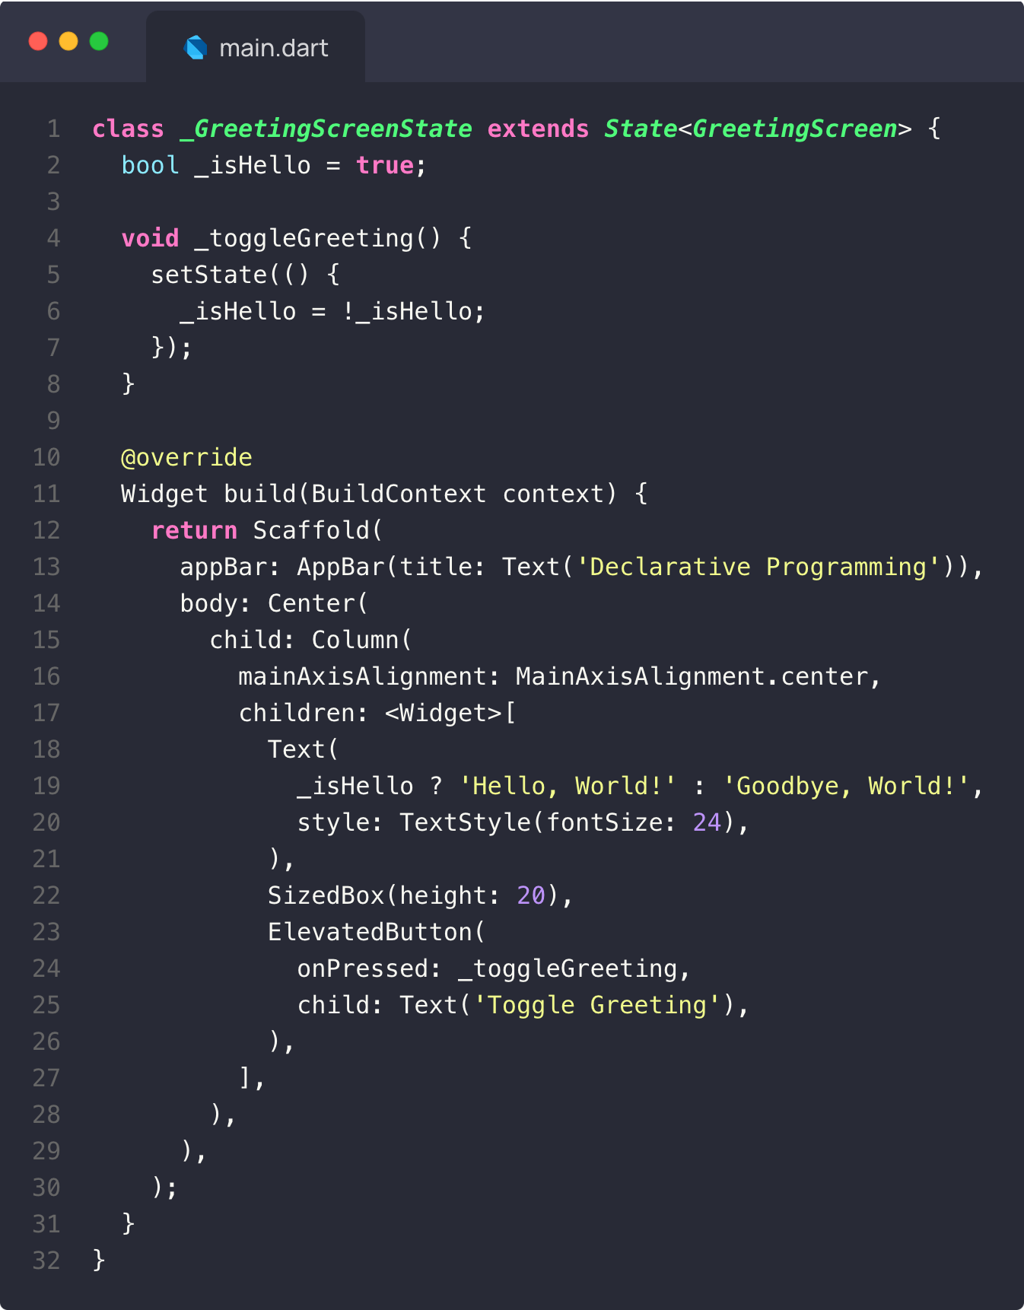
What is Flutter? Dart – Declarative
Declarative Style: The UI is built using a tree of widgets that describe the structure and appearance of the app at any given state.
State Management: The state is managed using the setState method to trigger a rebuild of the UI with the new state.
Readability: The code is easy to read and understand because it focuses on what the UI should look like, not how to construct it step by step.
https://10015.io/tools/code-to-image-converter

Slide 7
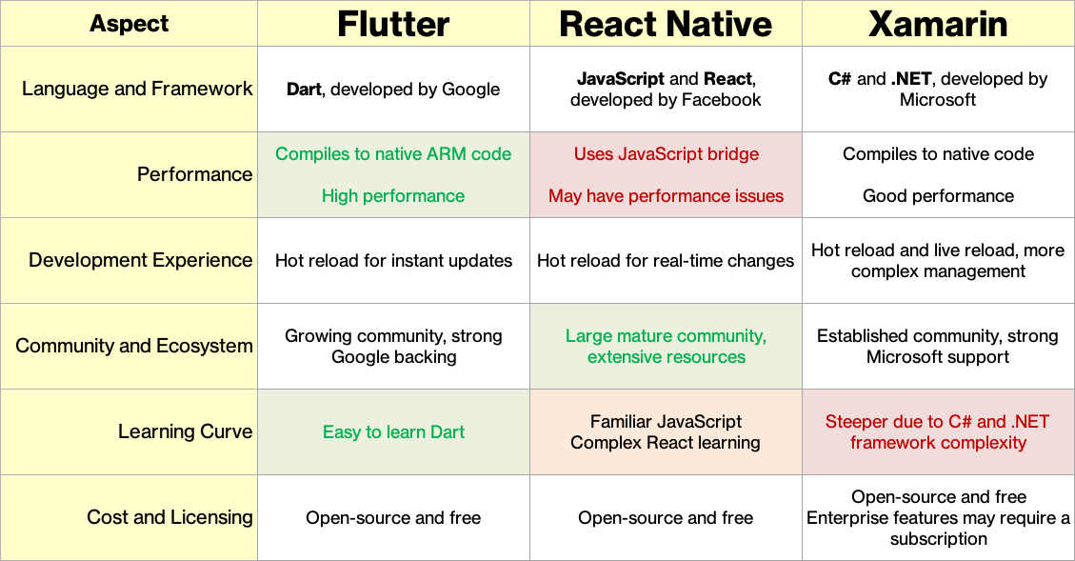
What is Flutter? Comparisons

Slide 8




What is Flutter? Popular Apps by Flutter
BMW My BMW App was launched in July 2020 and has established itself in 47 countries on five continents as a universal interface providing the user a seamless experience between mobile phone and vehicle.
eBay Motors eBay Motors ships a new version of their app to both app stores every week. Their apps share 98.3% of their code, the eBay Motors app has a single source of truth — which means one set of meetings, one set of designs, one backlog queue, and one team to manage.
Google Pay 1.1 million lines of code instead of 1.7 million from previous native versions. At the same time, the team estimates that they’ve saved about 60-70% of their engineers’ time because a single codebase.
Nubank Nubank is the largest independent digital bank outside of Asia, giving over 48 million users financial banking tools. Flutter provides more UI consistency.

Slide 9
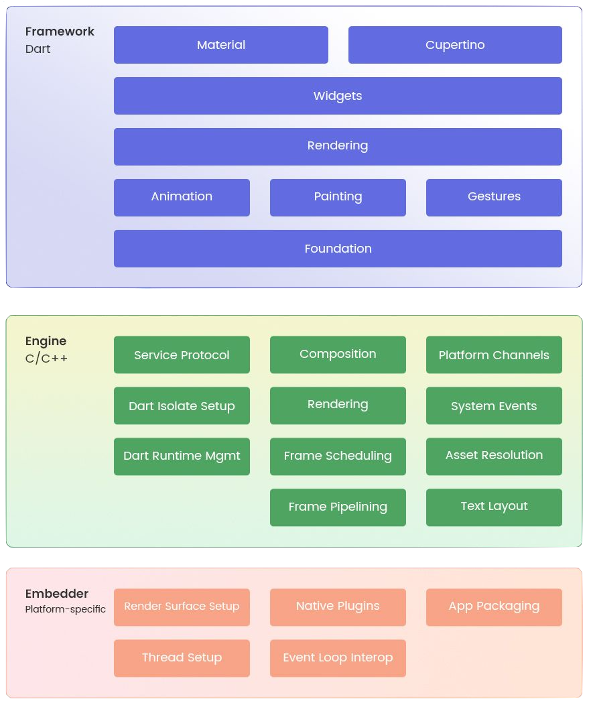
Flutter Architecture
Flutter Framework – Developers Work Here
It is a very core part of Flutter app architecture. Flutter framework has got the material parts, widgets, or the Cupertino, and it becomes the foundation element of application development.
Flutter Engine – Google Team Works Here
Written in C++, this Flutter engine tackles and handles the heavy liftings in software development like the network requests, input, and output, along with managing the complex translations of rendering.
Embedder – Specific to Deployment OS
The embedder layers undertake the heavy lifting necessary to translate how Flutter language works with the particular OS.
Flutter user interfaces are developed, composited, and painted by Flutter itself and not translated into a similar OS Widget.
https://radixweb.com/blog/overview-of-flutter-architecture

Slide 10

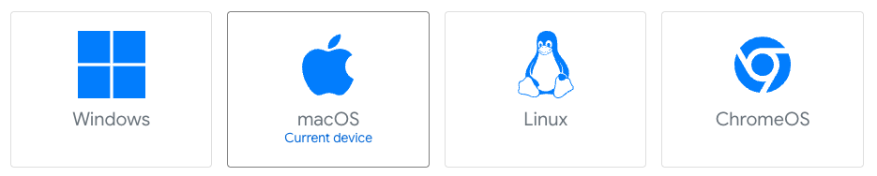
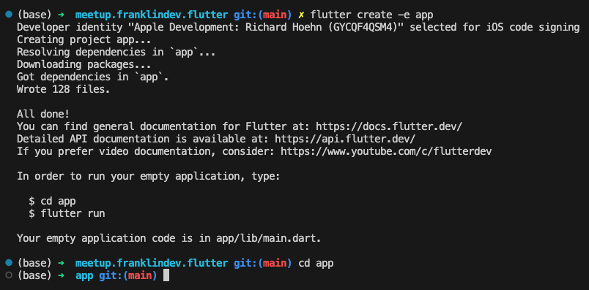
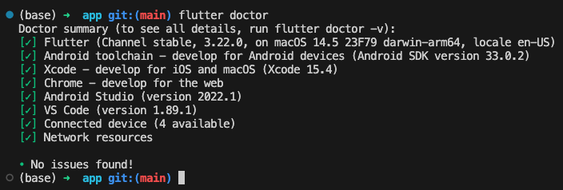
Setting Up Flutter
System Requirements
Windows, Mac, and Linux – All need to be 64bit
Disk – You will need ~2GB
GIT by default (.gitignore added)
Flutter Doctor
Environment Check
Diagnostic on Miss-Configuration
Cross Platform Support on different OS Developer machines

Slide 11
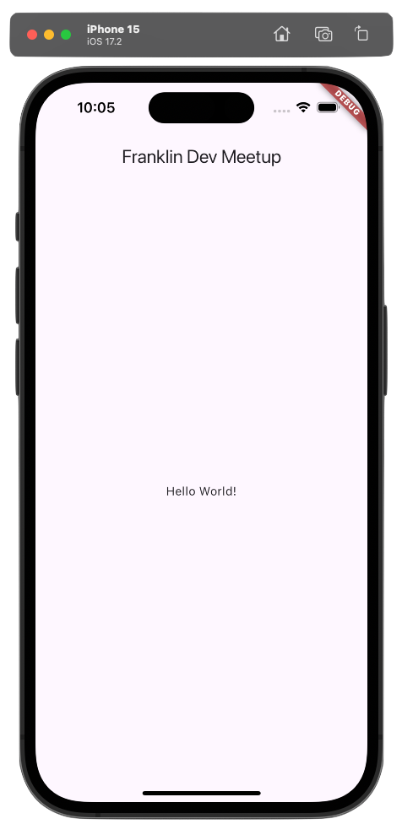
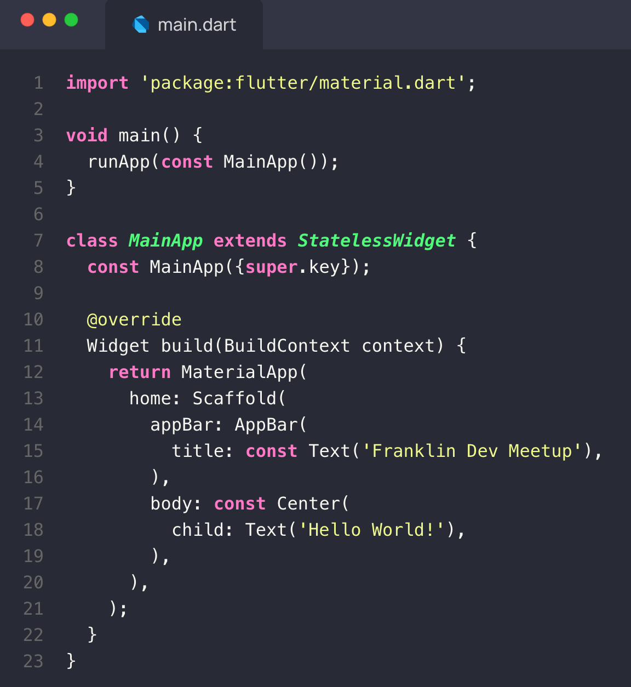
Widget Tree – All Things are Widgets
Application Root
MainApp
Scaffold
AppBar
Center
Text
Text
MaterialApp
https://10015.io/tools/code-to-image-converter

Slide 12
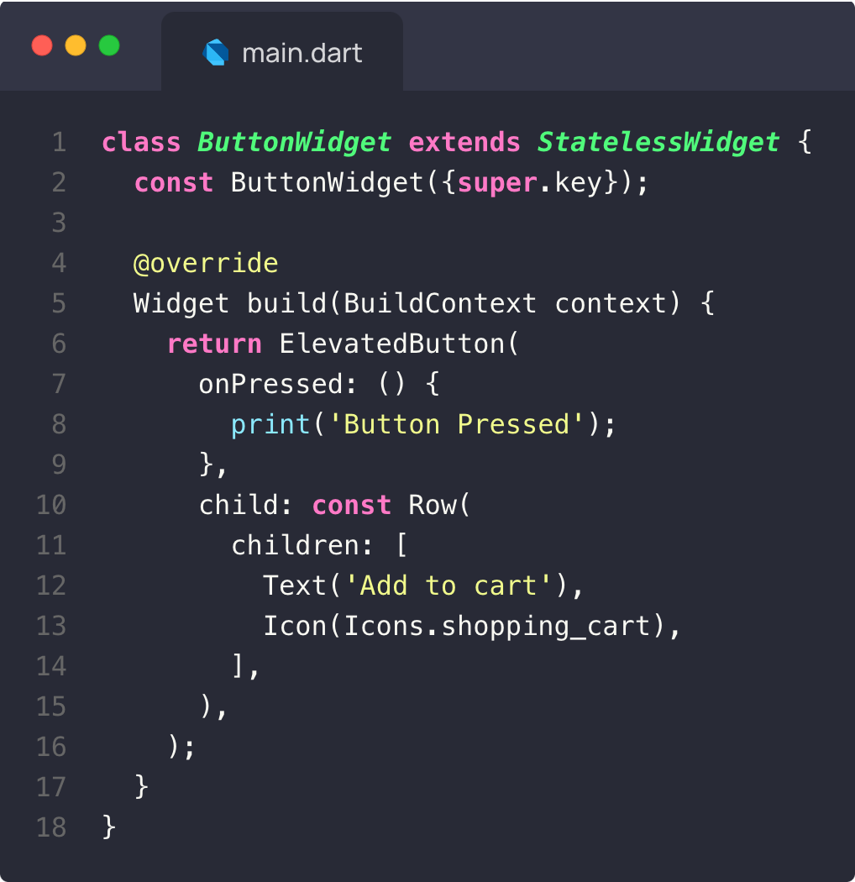
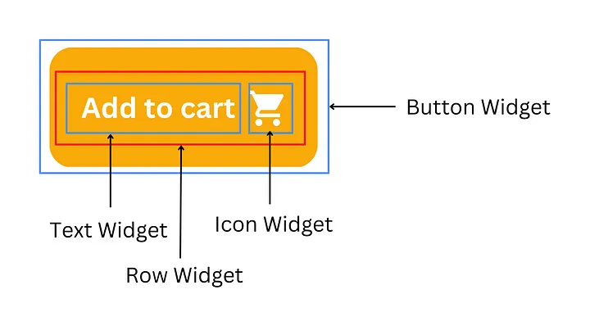
Widget Tree Nesting of Widgets
https://medium.com/gytworkz/understanding-flutter-widgets-and-architecture-98ee1f209b96

Slide 13
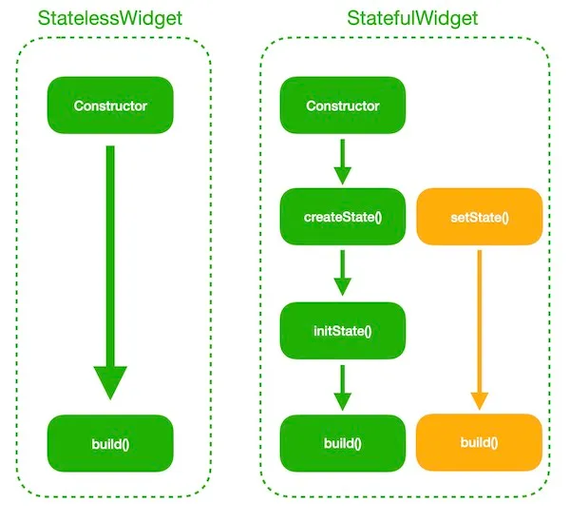
Widget Tree Stateful & Stateless Widgets
Flutter has 2 Types of Widgets Stateless & Stateful
Stateless – Immutable …widgets do not contain state hence they can be updated only when it’s parent changes.
Stateful – Mutable …widgets can hold the states internally, so they can be updated when its states changes and when it’s parent changes.
Why? …straight forward lifecycle and memory management.
Developers can use stateless widgets for static content and stateful widgets for dynamic content, optimizing both performance and interactivity.
https://medium.com/gytworkz/understanding-flutter-widgets-and-architecture-98ee1f209b96

Slide 14
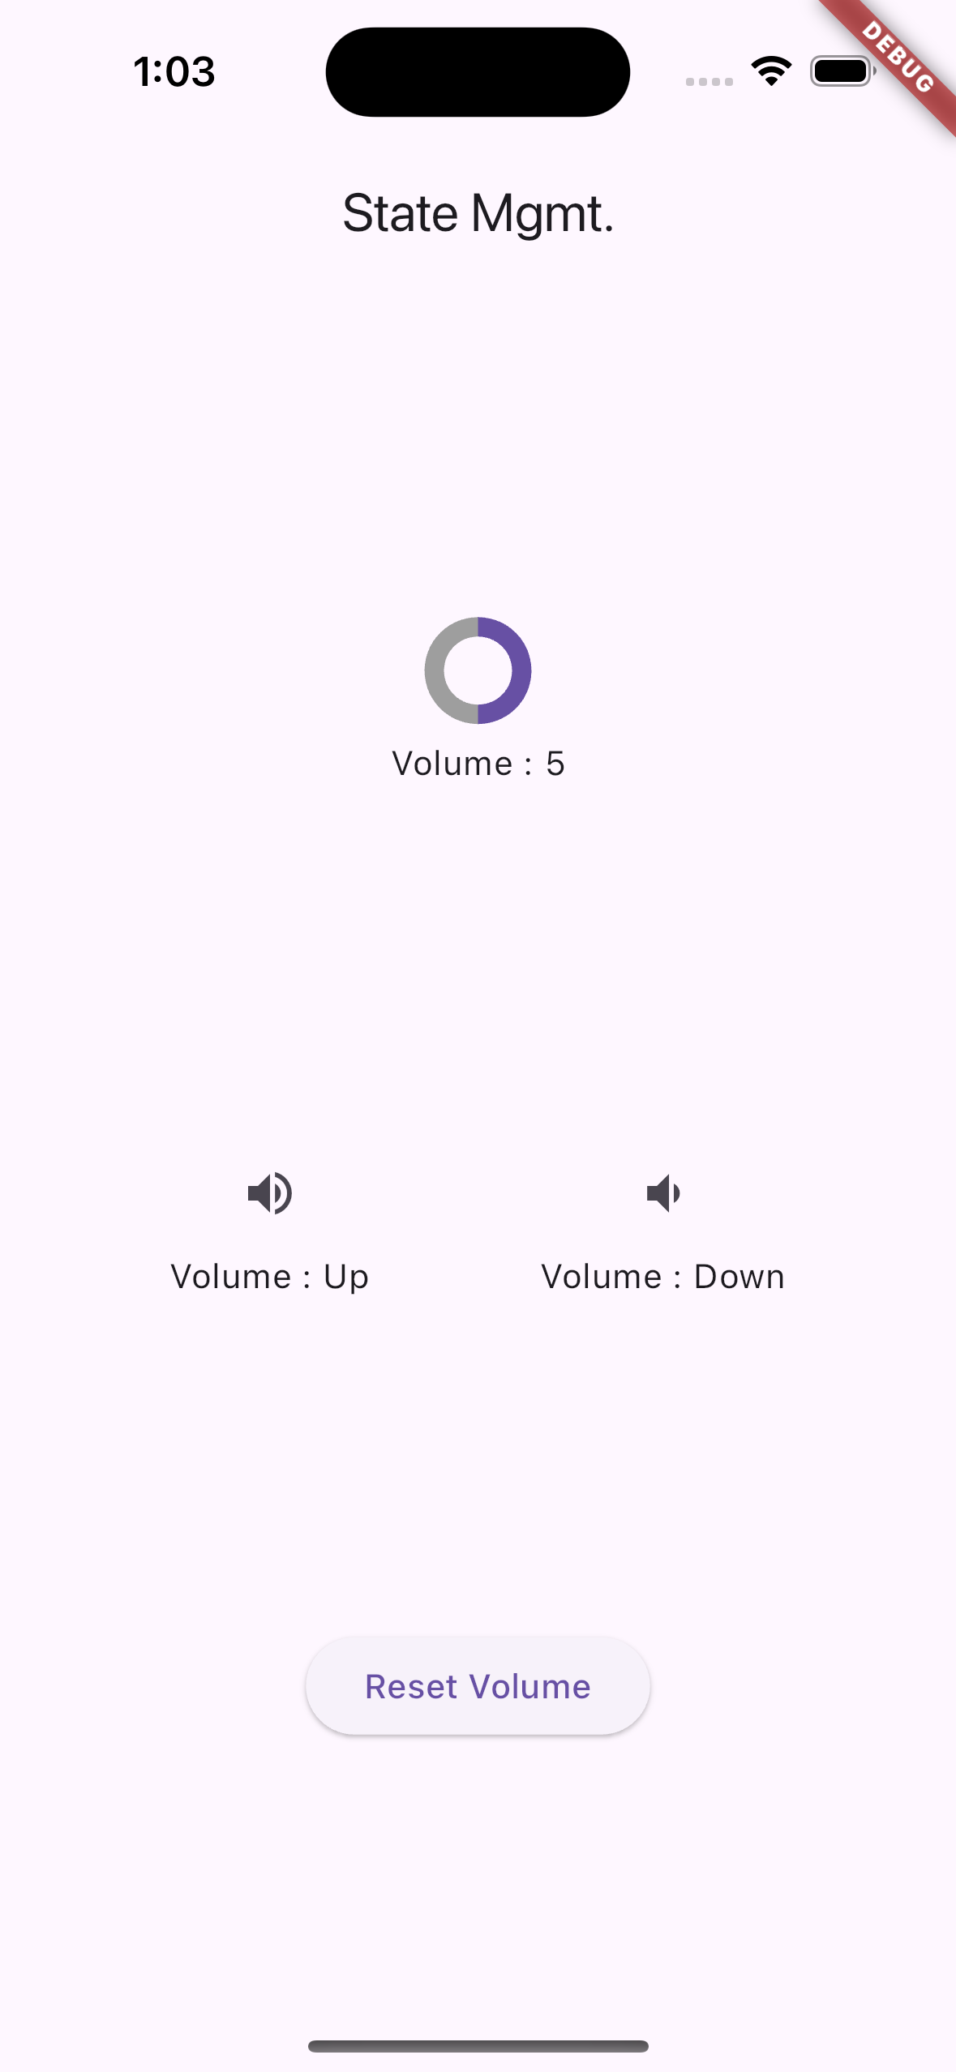
State Management
Reactive programming updates the (UI) anytime the underlying data (state) changes.
Centralized State Control: State management allows you to centralize the control of the application's state, making it easier to manage and update the state consistently across the app.
Improved Scalability: As your application grows, state management helps maintain a clean and organized codebase by separating the UI from the business logic.
Enhanced Debugging and Testing: With state management, debugging and testing become more straightforward because the state transitions and changes are controlled and observable.
React Native Equivalent: This would be Redux or MobX

Slide 15

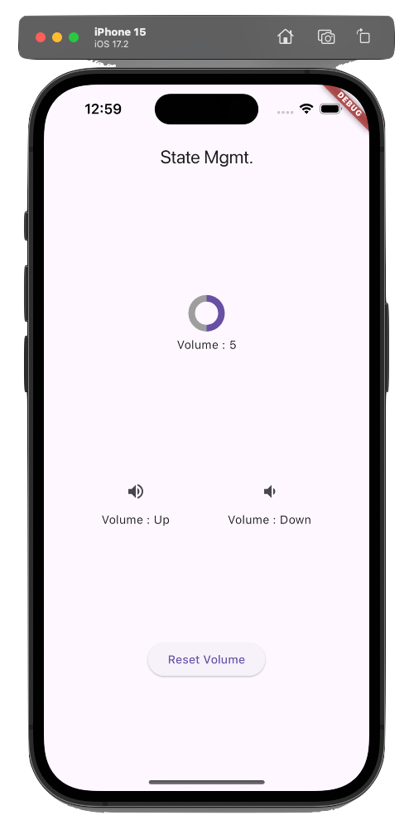
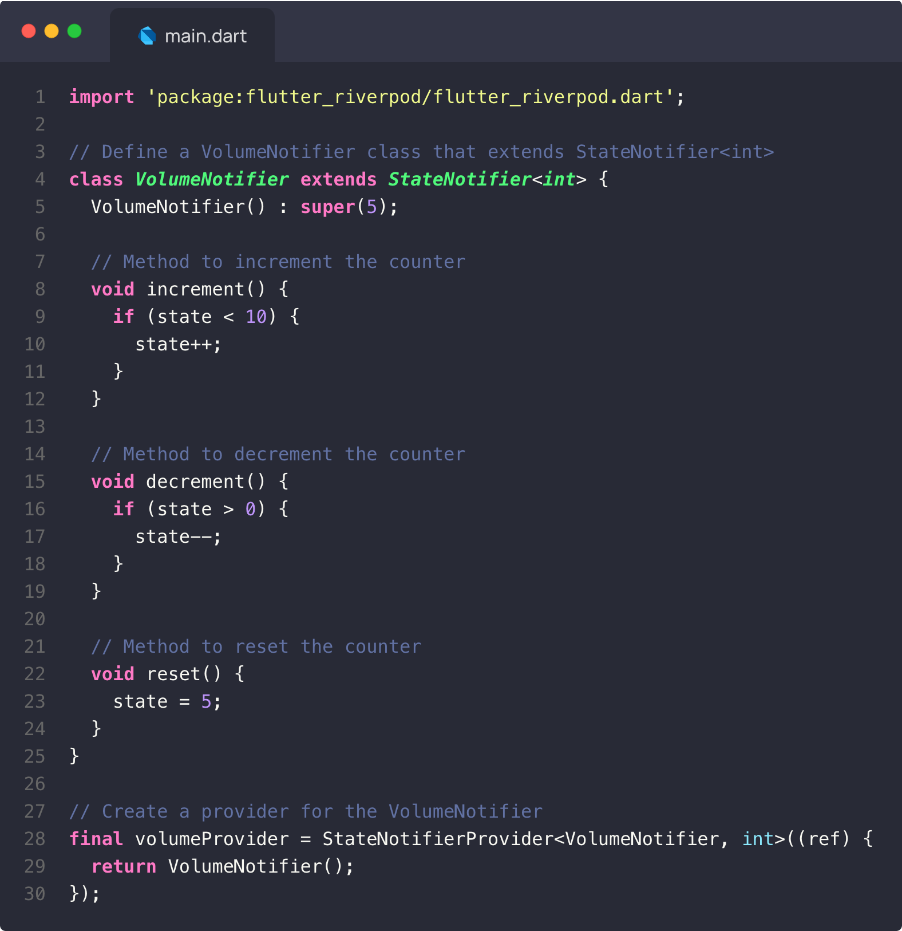
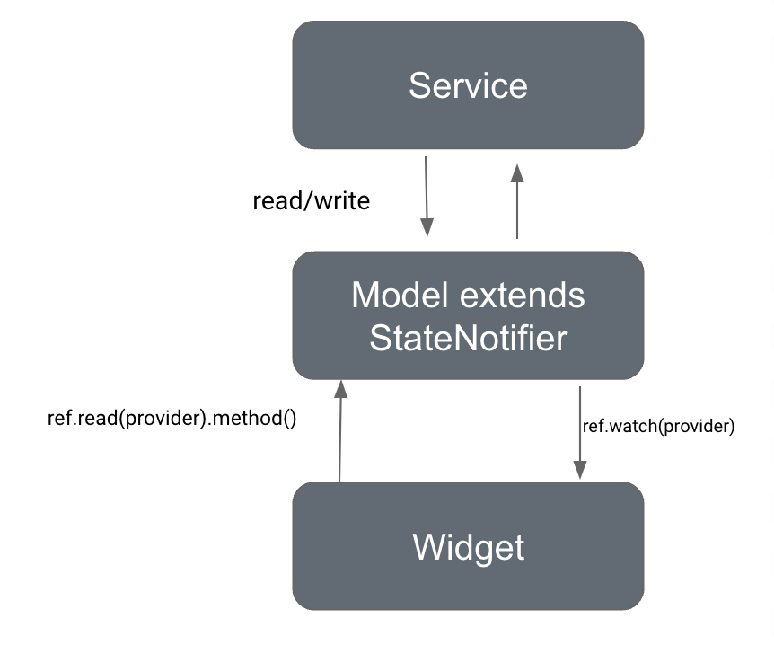
State Management Riverpod Example

Slide 16

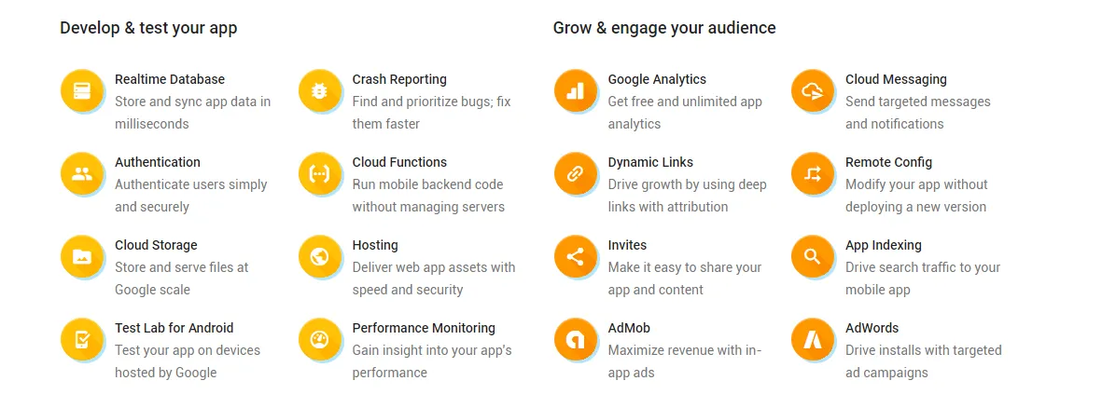
Firebase
Provides a set of Tools & Services that work together, simplifying the development process.
Offers real-time data synchronization and communication
Supports apps of all sizes, from small projects to large-scale applications (Note: $$$ pricing like AWS)

Slide 17




Firebase Four (4) Key Modules I use
Authentication Firebase Authentication provides an easy way to handle user authentication. It supports various authentication methods such as email/password, Google, Facebook, and phone number authentication. This allows you to securely authenticate users without having to build your own backend authentication system.
Realtime Database and Firestore Firebase offers two cloud-hosted database solutions: Realtime Database and Firestore. Realtime Database is a NoSQL database that stores data in a JSON format and synchronizes data in real-time across all clients. Firestore, on the other hand, is a more flexible and scalable NoSQL database that supports complex querying and offline data access..
Cloud Functions Firebase Cloud Functions (AWS Lambda) allow you to run backend code in response to events triggered by Firebase features and HTTPS requests. This serverless architecture helps you execute code without managing servers, enabling you to extend the functionality of your Flutter app with custom backend logic.
Analytics and Performance Monitoring Firebase Analytics provides insights into user behavior and engagement, helping you understand how users interact with your app. Additionally, Firebase Performance Monitoring offers real-time performance data, allowing you to identify and fix performance issues.

Slide 18
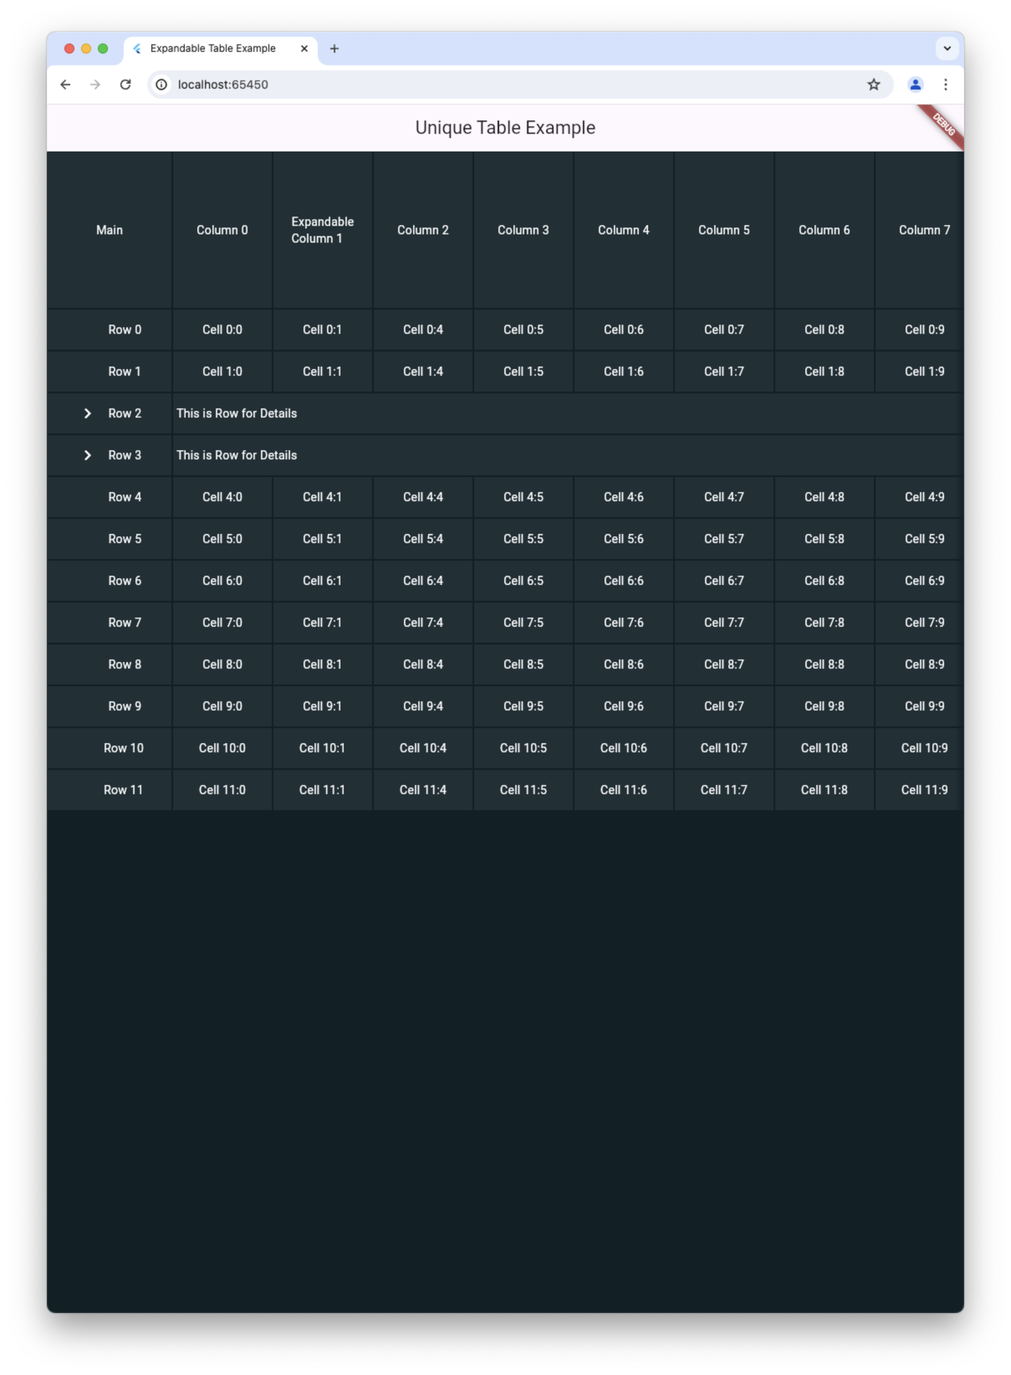
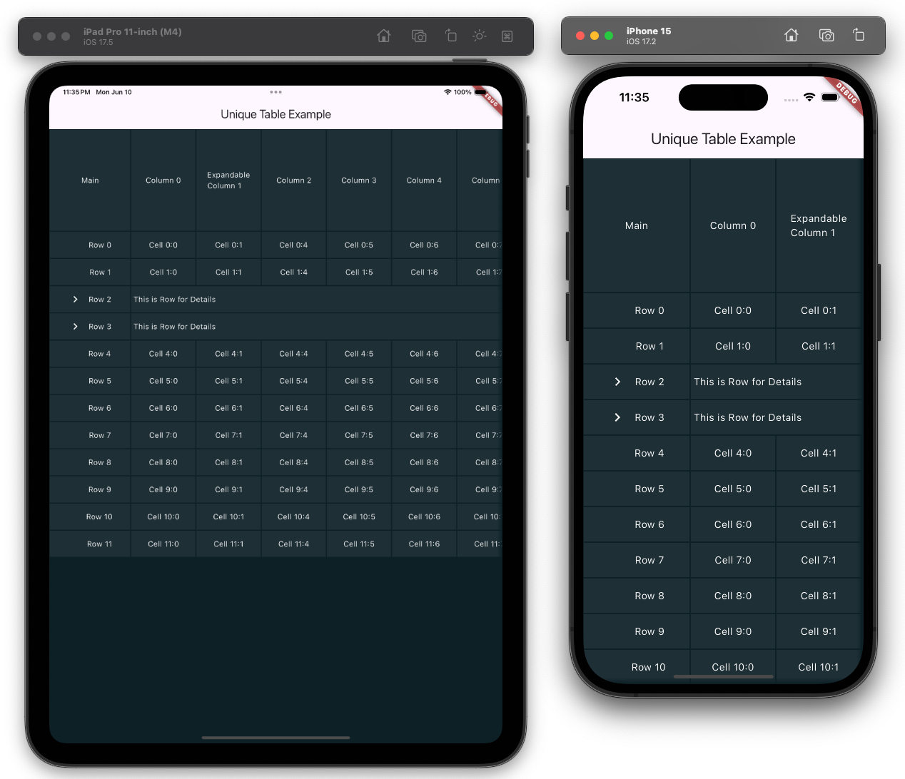
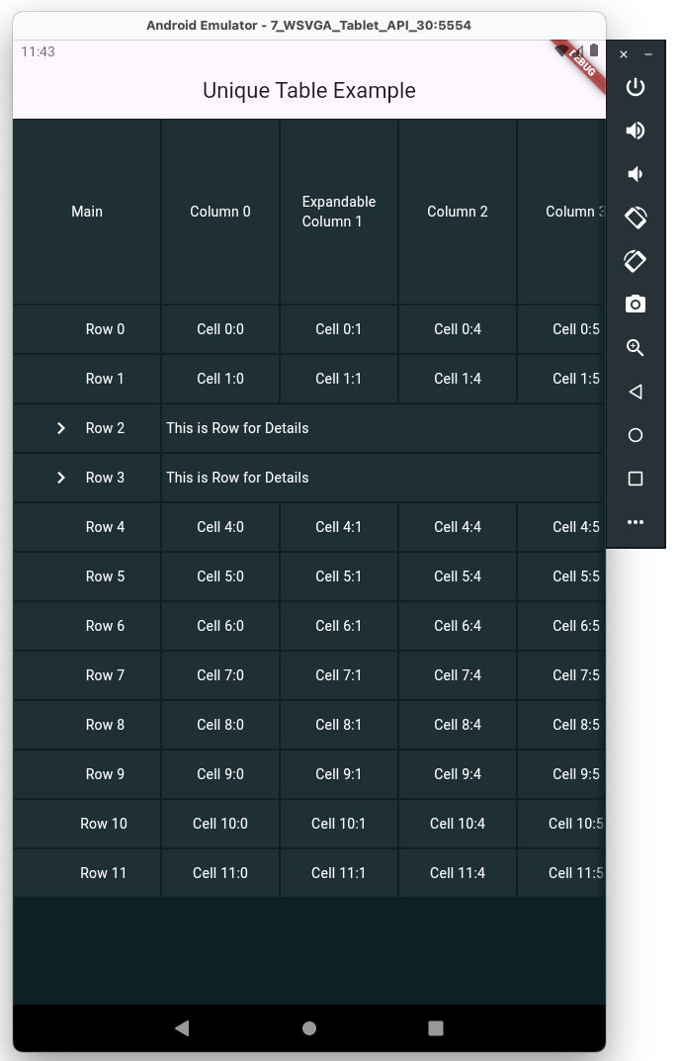
Unique Features of Flutter
Consistent UI across platforms due to custom rendering engine!
Demo Example!
https://pub.dev/packages/flutter_expandable_table/example

Slide 19


